Slide 1
The HealthierUS School Challenge (HUSSC)
Notes:
Many of you have had the pleasure of enjoying several webinars and trainings on the HealthierUS School Challenge already, but we will be discussing it again today. As many of you know, The HealthierUS School Challenge is a voluntary initiative established in 2004 to recognize schools participating in the NSLP and SBP that have created healthier school environments through promotion of nutrition and physical activity.
All of us work with children, and we know that childhood obesity has become a national concern. Children are now developing diseases, such as Type II Diabetes and Hypertension, that in previous years were seen only in obese or overweight adults. While there are many contributing factors, an increased consumption of calories and a decrease in physical activity are the major contributors. Schools can provide an excellent opportunity to influence children’s health habits, and this is something that has been recognized nationally. USDA has set the wheels in motion to decrease this epidemic through new NSLP and SBP meal patterns, increased Wellness Policy requirements, and by heavily promoting initiatives such as the HealthierUS School Challenge.
We Student Nutrition professionals have the opportunity to help children of all ages develop lifetime health habits. We put in countless hours of hard work each day to ensure that hungry children receive nutritious, well-balanced meals. You have all worked tirelessly to implement the new meal pattern requirements, and you all deserve to be heavily recognized for your commitment to bettering the lives of children. Through the HealthierUS School Challenge you can all receive your well-deserved recognition. Todays HUSSC presentation will focus on meeting the challenge requirements for the different award levels, which many of you most likely are in some way or another, and applying for the HUSSC certification in order to receive recognition and a monetary incentive!

Slide 2
Award Levels
HUSSC criteria is specific for 4 levels of recognition:
Bronze
Silver
Gold
Gold Award of Distinction
Notes:
HUSSC criteria is specific for 4 levels of recognition:
Bronze
Silver
Gold
Gold Award of Distinction
Each school applies for HUSSC certification at a certain award level, either bronze, silver, gold, or gold award of distinction. Of course, each award level becomes increasingly more difficult to meet. With the implementation of the new meal patterns and increased program requirements, many schools are already meeting at least the bronze criteria in elementary schools. We will not go into depth about specific criteria for each award level, but there is a hand-out in your training packets that outlines the specific criteria for each award level and we have a reviewer that is available for on-site HUSSC training. We will also begin doing monthly webinars to increase knowledge and help schools achieve the HUSSC certification.
There are monetary incentives associated with each award level. Monetary incentives are as follows for each award level:
Bronze: $500
Silver: $1000
Gold: $1500
Gold Award of Distinction: $2000
Not only do certified HUSSC schools receive monetary incentives, but they also receive national recognition. HUSSC schools are posted on the USDA HUSSC webpage, receive a HUSSC display banner, a certificate signed by the Secretary of Agriculture and mounted in a protective plaque, and a congratulatory letter signed by the First Lady. Many schools have also received community recognition at a high-level, including newspaper articles, radio slots, press conferences, and in larger cities tv interviews.

Slide 3
Challenge Criteria
Participate in the NSLP and SBP
Be a Team Nutrition school
Be 6-cent certified
Serve reimbursable breakfast & lunches that meet the 2010 DGA’s and meet USDA nutrition standards
Submit your School Wellness Policy
Provide nutrition education, physical education, and opportunities for physical activity
Complete all CA from most recent NSLP review
Provide more nutritious competitive foods
Notes:
Many of you are already aware of the HUSSC criteria, and due to limited time, todays presentation will be a brief overview of the criteria, highlighting how many of you are already close to meeting the criteria and becoming certified as a HUSSC school.
Some of the common criteria between the different award levels, include:
Participate in the NSLP and SBP
Be Enrolled as a Team Nutrition School (it’s super simple, and takes 5 min to do online)
Be 6-cent certified (many of you already are, and if you’re not already you will be by the end of the year. ☺)
Serve reimbursable breakfasts & lunches that meet the 2010 DGA’s and meet USDA nutrition standards (HUSSC has heightened criteria, such as serving 3-4 different types of fresh fruit per week, although we do have a waiver if your school is unable to provide fresh fruit that often), offer 1-2 additional servings of vegetables per week, serve more whole-grain rich items and a larger variety).
Submit your School Wellness Policy (as we will discuss in the next presentation, School Wellness Policies will be required to become a living breathing document and schools will begin to have their Wellness Policies evaluated during NSLP Admin Reviews).
Provide nutrition education, physical education, and opportunities for physical activity (schools must provide nutrition education in specific amounts established by USDA for each grade level to meet HUSSCC criteria, as well as physical education and physical activity).
Complete all CA from your most recent NSLP Admin Review (all of you are currently incompliance and fulfilled all corrective actions from your most recent NSLP Admin Review).
Provide more nutritious competitive foods (if you serve competitive foods they must meet the HUSSC criteria. This will become increasingly easy to meet as the new competitive food requirements are released).

Slide 4
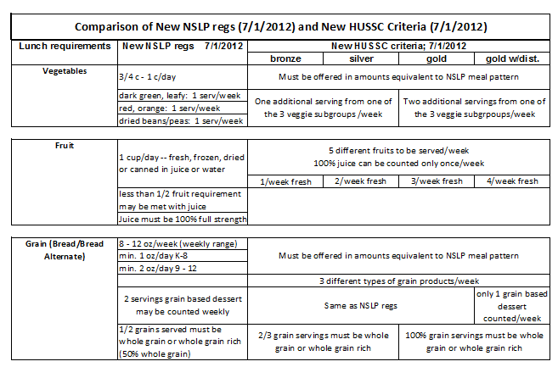
NSLP/HUSSC Lunch Criteria Comparison
Notes:
A hard copy of this NSLP comparison request is available in your packets (blue copy). It outlines the lunch requirements.
In addition to being 6-cent certified, schools must meet certain menu requirements to be certified as a HUSSC school. Many of these requirements align with the current meal patterns, but have additional stipulations. Many schools can easily meet the HUSSC Bronze criteria just by making a few menu tweaks.
Discuss criteria listed on chart

Slide 5
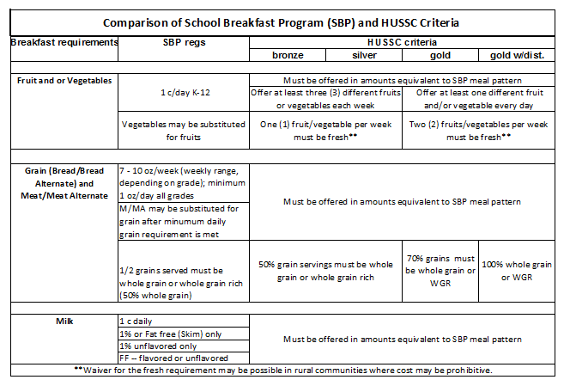
SBP/HUSSC Criteria Comparison
Notes:
A hard copy of the SBP Meal Pattern Requirements compared to the HUSSC Breakfast Criteria is also available in your training packets (green copy).
As with Lunch, The HUSSC Breakfast requirements align closely with the new SBP meal patterns but have additional stipulations.
Discuss SBP requirements

Slide 6
Other Criteria For Excellence
Schools must select from a list of options that reflect HUSSC excellence in different areas. Such options include:
Breakfast in the Classroom
At-Risk Afterschool Participation
SFSP Participation
Walk/Bike to School Day
Recess Before Lunch
Chefs Move to Schools
Smarter Lunchroom Techniques
Notes:
New this year in HUSSC criteria is ‘Other Criteria for Excellence’
Other Criteria for Excellence allows schools to choose to highlight other activities that promote the following:
Program Outreach: This includes Breakfast in the Classroom, participation in the At-Risk Afterschool Program, or participation in the Summer Food Service Program.
Physical Activity: Walk or Bike to School Day or Recess Before Lunch
Nutrition Education: Using TN nutrition education curricula, or working with Chefs Move to Schools
Community Involvement: Training staff in Physical Activity, Wellness, nutrition, or partnering with community groups to promote wellness.
School Food Service Excellence: Using smarter lunchroom techniques to encourage students to select more fruits, veggies, and dry beans or peas; providing grab-and-go meals that meet the new requirements.
Schools must promote above listed activities to become certified as a HUSSC schools. The Number of options that a school must accomplish varies by award level:
Bronze: 2
Silver: 4
Gold: 6
Gold Award of Distinction: 8

Slide 7
How To Meet The HUSSC Criteria
Form a school challenge team
Solicit & inform parents, teachers, school nurses, community members, school admin staff, etc.
Work with the State Agency staff to receive technical assistance meeting the criteria and completing the application
Seek resources and additional training through organizations such as NFSMI
Notes:
Meeting the HUSSC criteria can be challenging if you don’t have support from your school and community. In order to meet the challenge criteria schools must form a challenge, or wellness team. Many schools will be creating ‘Wellness Teams’ in order to fully implement their Local Wellness Policy, which we will be discussing in the next presentation. Some schools have also received grants through H&SS to hire Wellness Coordinators, who will work with schools on Wellness Policies and HUSSC, among other things.
Wellness Policies and HUSSC are closely connected, and I believe that once schools begin to develop, evaluate, and implement their Wellness Policies they will be meeting the HUSSC criteria. There is a checklist available in your packets that will be helpful in determining where school currently stands with meeting the HUSSC criteria. Once you know the areas in which you’re lacking, you can work towards improving those areas to strengthen your school health environment and receive recognition as a HUSSC school. Your School Challenge or Wellness Team can work with you to meet the areas which need improving.
The State Agency has a reviewer that can provide technical assistance for HUSSC, and will also work with schools one-on-one through phone communication in order to meet the criteria and complete the application process. We will also begin monthly HUSSC and Wellness Policy Webinars that will highlight certain topics each time.
There are several resources available through Team Nutrition, the Alaska Child Nutrition Programs website, NFSMI, and various other online sites. There is a resource sheet in your packets as well.
Becoming certified as a HUSSC school is only achievable when the school or district tackles it as a team.

Slide 8
Applying for HUSSC
Review the HUSSC checklist for the award level in which you’re applying for to ensure you’re meeting all of the criteria
Complete the HUSSC Application
Submit all supporting documentation:
a. Wellness Policy
b. TN registration verification
c. 2 full week cycle menu for reimbursable breakfast & lunches
d. Lunch 6-cent certification worksheets for the 2 week period
e. Production Records for 2 weeks (not required for bronze)
f. Meal documentation (CN labels, nutrition facts, whole-grain rich documentation
g. Competitive foods documentation (if app.)
*Please contact the State Agency for application & initiative assistance*
Notes:
When schools or districts feel that they’ve met the HUSSC criteria and are ready to apply, you should take the following steps:
Review the HUSSC checklist for the award level in which you’re applying for to ensure you’re meeting the HUSSC criteria. There is a checklist available in your packets, and we will be creating checklists specific to each award level in the next month. We will send these out once they’re available.
Complete the HUSSC application: The HUSSC application is available on our website, or the USDA website. You can complete it electronically, or print it and complete it by hand. It’s a bit lengthy, but will encompass all of the challenge criteria. We strongly encourage applicants to work with the State Agency in order to ensure that all criteria is being met and the application is ready to go.
Submit all supporting documentation:
Wellness Policy: Schools must submit their Wellness Policy and documentation for the following local school wellness policy criteria:
List three ways your school is working to meet local wellness policy goals
Describe how parents, students, school administration and staff, and the community are involved in the implementation of the local wellness policy at your school
4. TN registration verification: This can be printed from the TN website, and it verifies that you’re enrolled as a Team Nutrition school
5. 2 full week cycle menu for reimbursable breakfasts and lunches. A full week refers to the regular weekly cycle under which the school operates. A full week does not contain missed days due to holidays, teacher in service, inclement weather, etc. It’s important to evaluate your menus to ensure that they’re meeting all of the additional HUSSC menu criteria prior to submitting. The NSLP/SBP comparison charts will be helpful with this, as will your checklist
6. Lunch 6-cent certification worksheets for the two-week cycle menu period that is submitted
7. Production records for the 2 week cycle menu period that is submitted (this is not required for the bronze award level)
8. Meal documentation: This includes recipes, food product ingredient statements, and/or nutrition fact labels to verify that the criteria have been met for the following: whole-grain products, a la carte, snack bar, and vended items sold anytime, anywhere on the school campus
9. Competitive foods documentation: depending on what foods are offered on the menu and as competitive foods, schools may also need to submit product formulation statements from the manufacturer, or copies of the actual product label. Competitive foods criteria has not changed recently, however when the competitive foods rule is release and it is more restrictivve the HUSSC criteria will be updated to align with the new USDA competitive foods requirements (will discuss later this afternoon with Jo)

Slide 9
Resources
Team Nutrition
http://www.fns.usda.gov/tn/
Washington State Dairy Council
http://www.eatsmart.org/
NFSMI
nfsmi.org
Choose My Plate
http://www.choosemyplate.gov/
USDA Policy Memos
SP 10-2012 REVISED: Q & A on NSLP & SBP Nutrition Standards Final Rule
TA 03-2012: Revised HUSSC Criteria
Notes:
There is a resource sheet available in your training packets. It has additional resources listed other than what appears on the slide. I also want to mention again, that the State Agency can provide on-site technical assistance and training for HUSSC if schools are interested.
If you would like to receive on-site technical assistance from the State, please complete the technical assistance/training request form in your packets and submit to CNP.

Slide 10
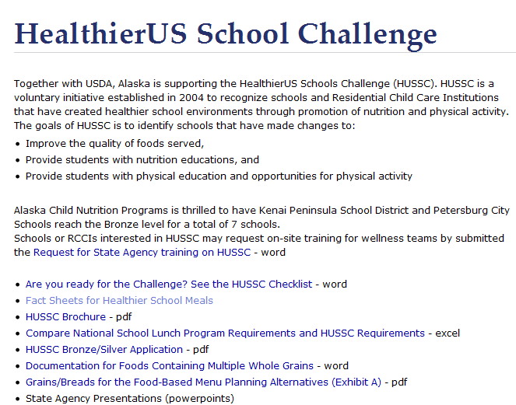
HealthierUS School Challenge
Notes:
Here’s a snapshot of the Alaska Child Nutrition HUSSC Webpage. It has links to various HUSSC resources and information., as well as fac sheets, the application material, the HUSSC checklist, and State Agency PowerPoints.
We will also begin doing monthly HUSSC webinars in the coming months, so keep your eyes peeled for announcements.

Slide 11
For additional support or questions, contact:
Cyde Coil
Child Nutrition Program Specialist
Cyde.coil@Alaska.gov
(907) 465-8719
Notes:
Again, I just want to reiterate that all of you have worked so hard to get your menus in compliance and to create healthier environments for the children you serve on a daily basis. You’ve come so far, and worked so hard and I think it’s important that this hard work not go unrecognized. I can assure quite a few of you that you’re already meeting, or very close to meeting the HUSSC criteria for at least bronze level. If you’ve made it this far, why not become certified as a HUSSC school and receive the recognition you deserve!
We are available for technical assistance and really encourage all of you to become certified under the HUSSC criteria.

