Slide 1
Alaska’s New Accountability System for Schools

Slide 2
How we got here
ESEA Flexibility Waiver application submitted in October 2012
Approved by US Department of Education in May 2013
Permitted Alaska to develop new regulations for school accountability
Those regulations approved by the Alaska State Board of Education in June 2013

Slide 3
What it replaces
Adequate Yearly Progress
Expectation that 100% of students are proficient by Spring of 2013-2014 school year
Annual Measurable Objectives for 2012-2013 school year were 94.28% proficient in Language Arts; 91.53% proficient for math
Consequences that followed not meeting AYP
School improvement
Corrective action
Restructuring
Restricted use of Title funds

Slide 4
The New Accountability System
Alaska School Performance Index (ASPI)
New Annual Measurable Objective Targets

Slide 5
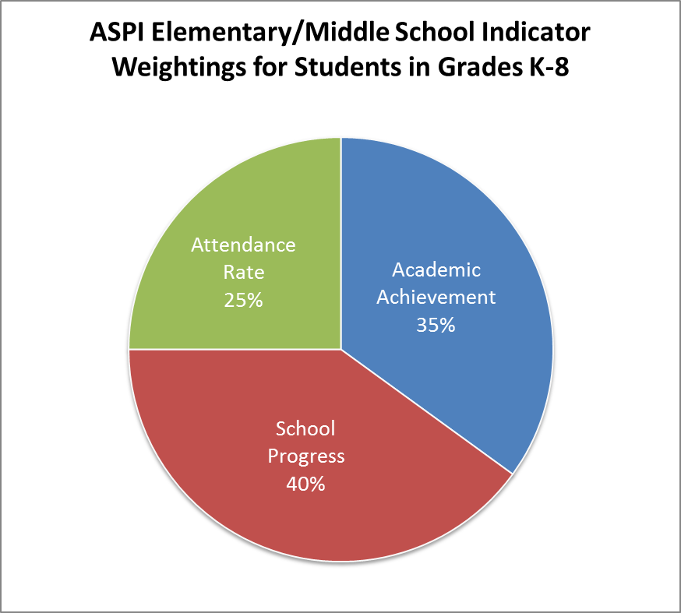

Slide 6
Academic Achievement
Average of % of students proficient or above in reading, writing, and math
Example: 100 students
85% proficient in reading = 85 students
80% proficient in writing = 80 students
75% proficient in math = 75 students
Total # proficient
85 students + 80 students + 75 students = 240 students
Average % proficient
240 students / 300 tested students = 80% proficient

Slide 7
80 x 35% = 28 ASPI points

Slide 8
School Progress
Progress from previous year’s SBAs
Uses 7 Proficiency Levels
Advanced
Proficient Plus
Proficient
Below Proficient Plus
Below Proficient Minus
Far Below Proficient Plus
Far Below Proficient Minus
Calculates progress for 5 Groups
All Students
Alaska Native
Economically Disadvantaged
Limited English Proficient
Students with Disabilities

Slide 9
Proficiency Levels

Slide 10
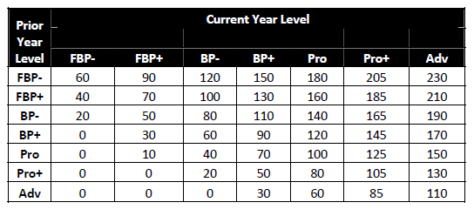
Growth & Proficiency Index

Slide 11
Group Weighting
Group | # of students | Index Score | Weight | Points
All Students | 110 | 96.42 | 70% | 67.49
Alaska Native | 10 | 103.13 | 10% | 10.00
Econ Dis | 47 | 98.85 | 10% | 9.89
Stud w/ Dis | 5 | 64.17 | 10% | 6.42
LEP | 4 | 64.17 | 0% | 0
TOTAL |  |  |  | 93.80
Notes:
Bump up Econ dis

Slide 12
80 x 35% = 28 ASPI points
93.8 x 40% = 37.52 ASPI points

Slide 13
Attendance Rate
Average attendance of all students
Example:
100 students
16,100 combined days of attendance
17,000 days of membership
16,100 / 17,000 = 94.7% attendance rate
Attendance Points
% Points
96-100 100
93-95 95
90-92 80
85-89 50
70-85 25
Below 70 0
Notes:
Determine whether or not to keep attendance rate this low…

Slide 14
95 x 25% = 23.75 ASPI points
80 x 35% = 28 ASPI points
93.8 x 40% = 37.52 ASPI points
TOTAL ASPI POINTS = 89.27

Slide 15
Star Ratings
ASPI Points
Number of Stars
94 – 100
85 – 93.99
65 – 84.99
55 – 64.99
0 – 54.99

Slide 16
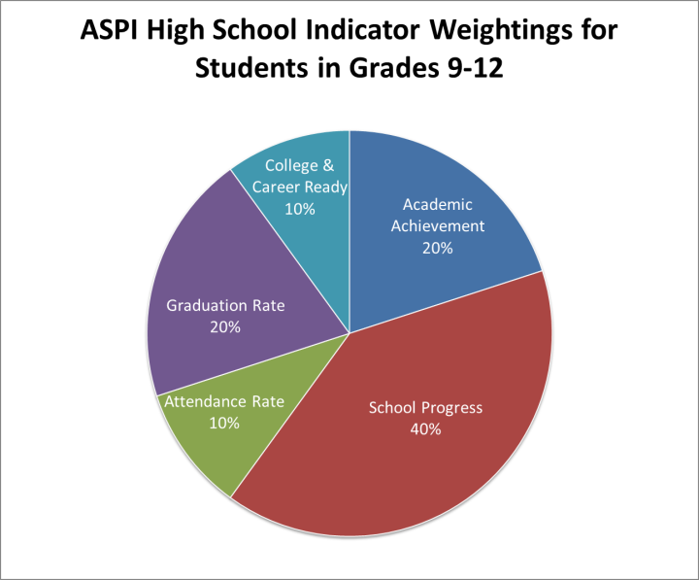
80 x 20% = 16 ASPI points
95 x 10% = 9.5 ASPI points
93.8 x 40% = 37.52 ASPI points

Slide 17
Graduation Rate
Use higher of 4-year or 5-year cohort rate (required graduation rate formula)
4 year rate | 5 year rate | Points
98-100 | 98-100 | 100
90-97 | 93-97 | 95
85-89 | 89-92 | 90
80-84 | 85-88 | 70
70-79 | 80-84 | 50
60-69 | 70-79 | 25
50-59 | 60-69 | 10
Below 50 | Below 60 | 0

Slide 18
80 x 20% = 16 ASPI points
90 x 20% = 18 ASPI points
95 x 10% = 9.5 ASPI points
93.8 x 40% = 37.52 ASPI points

Slide 19
College & Career Ready Indicator
Points earned for each certificate/score level as shown
# students tested (current 12th graders tested in either 11th and/or 12th grades) in any WorkKeys, ACT, or SAT assessment
% calculated based on total number of points earned divided by number of students tested
WorkKeys Certificate | ACT Score | SAT Score | Points
Gold or Platinum | 25 | 1680 | 100
Silver | 23 | 1560 | 95
Bronze | 21 | 1450 | 80

Slide 20
College & Career Ready Indicator
120 12th graders
100 took assessment
60 got qualifying points
20 x 100 = 2,000 points
20 x 95 = 1,900 points
20 x 80 = 1,600
WorkKeys Certificate | ACT Score | SAT Score | Points
Gold or Platinum | 25 | 1680 | 100
Silver | 23 | 1560 | 95
Bronze | 21 | 1450 | 80
5,500 points / 100 = 55 ASPI Points

Slide 21
55 x 8% = 4.4 ASPI points
80 x 20% = 16 ASPI points
90 x 20% = 18 ASPI points
95 x 10% = 9.5 ASPI points
93.8 x 40% = 37.52 ASPI points

Slide 22
College & Career Indicator Participation Rate
WorkKeys weighted at 2% for 11th graders who take test
Participation Rate | Points
95-100 | 100
90-94 | 50
0-89 | 0

Slide 23
0 x 2% = 0 ASPI points
55 x 8% = 4.4 ASPI points
80 x 20% = 16 ASPI points
90 x 20% = 18 ASPI points
95 x 10% = 9.5 ASPI points
93.8 x 40% = 37.52 ASPI points
TOTAL ASPI POINTS = 85.42

Slide 24
Star Ratings
ASPI Points
Number of Stars
94 – 100
85 – 93.99
65 – 84.99
55 – 64.99
0 – 54.99

Slide 25
Annual Measurable Objectives
Targets set
In reading, writing, and math
For all-students group and for subgroups
For State, districts, and schools
Goal
To reduce by ½ over a 6-year period the number of non-proficient students
Reduction in equal increments over 6 years
School AMO targets met if
School or state target is met
Graduation rate and participation rate are met

Slide 26
AMO Example
2012
Percent not proficient in reading = 24%
Percent proficient in reading = 76%
2018 Targets
Percent not proficient in reading = 12%
Percent proficient in reading = 88%
Each year
12% / 6 years = 2% reduction (or increase) each year

Slide 27
Based on 2012 % proficient of 76%

